Slide 1
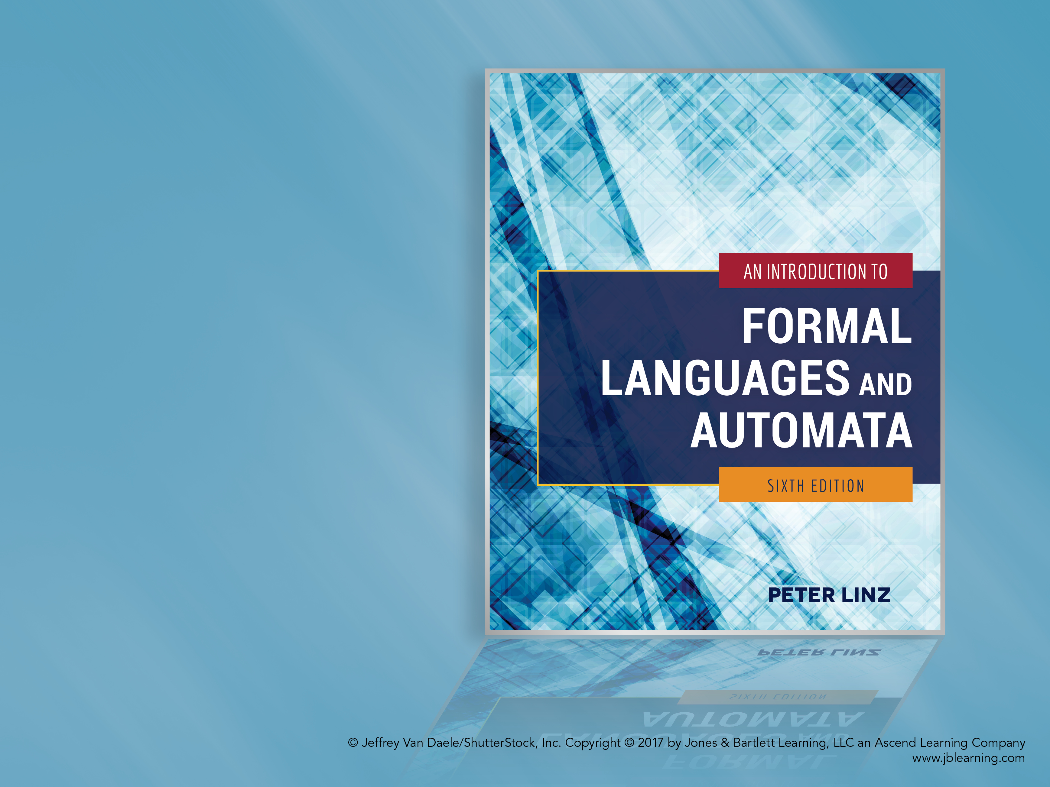
Chapter 12
LIMITS OF ALGORITHMIC COMPUTATION

Slide 2

Learning Objectives At the conclusion of the chapter, the student will be able to:
Explain and differentiate the concepts of computability and decidability
Define the Turing machine halting problem
Discuss the relationship between the halting problem and recursively enumerable languages
Give examples of undecidable problems regarding Turing machines to which the halting problem can be reduced
Give examples of undecidable problems regarding recursively enumerable languages
Determine if there is a solution to an instance of the Post correspondence problem
Give examples of undecidable problems regarding context-free languages

Slide 3
Computability and Decidability
Are there questions which are clearly and precisely stated, yet have no algorithmic solution?
As stated in chapter 9, a function f is computable if there exists a Turing machine that computes the value of f for all arguments in its domain
Since there may be a Turing machine that can compute f for part of the domain, it is crucial to define the domain of f precisely
The concept of decidability applies to computations that result in a “yes” or “no” answer: a problem is decidable if there exists a Turing machine that gives the correct answer for every instance in the domain

Slide 4
The Turing Machine Halting Problem
The Turing machine halting problem can be stated as: Given the description of a Turing machine M and an input string w, does M perform a computation that eventually halts?
The domain of the problem is the set of all Turing machines and all input strings w
Any attempts to simulate the computation on a universal Turing machine face the problem of not knowing if/when M has entered an infinite loop
By Theorem 12.1, there does not exist any Turing machine that finds the correct answer in all instances; the halting problem is therefore undecidable

Slide 5
The Halting Problem and Recursively Enumerable Languages
Theorem 12.2 states that, if the halting problem were decidable, then every recursively enumerable language would be recursive
Assume that L is a recursively enumerable language and M is a Turing machine that accepts L
If H is a Turing machine that solves the halting problem, then we can apply H to the accepting machine M
If H concludes that M does not halt, then by definition the input string is not in L
If H concludes that M halts, then M will determine if the input string is in L
Consequently, we would have a membership algorithm for L, but we know that one does not exist for some recursively enumerable languages, therefore contradicting our assumption that H exists

Slide 6
Reducing One Undecidable Problem to Another
A problem A is reduced to a problem B if the decidability of A follows from the decidability of B
An example is the state-entry problem: given any Turing machine M and string w, decide whether or not the state q is ever entered when M is applied to w
If we had an algorithm that solves the state-entry problem, it could be used to solve the halting problem
However, because the halting problem is undecidable, the state-entry problem must also be undecidable

Slide 7
The Blank-Tape Halting Problem
Given a Turing machine M, determine whether or not M halts if started with a blank tape
To show that the problem is undecidable,
Given a machine M and input string w, construct from M a new machine M_{w} that starts with a blank tape, writes w on it, and acts like M
Clearly, M_{w} will halt on a blank tape if and only if M halts on w
If we start with M_{w} and apply the blank-tape halting problem algorithm to it, we would have an algorithm for the halting problem
Since the halting problem is known to be undecidable, the same must be true for the blank-tape version

Slide 8
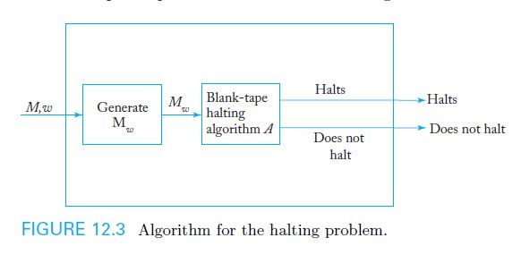
The Undecidability of the Blank-Tape Halting Problem
Figure 12.3 illustrates the process used to establish the result that the blank-tape halting problem is undecidable
After M_{w} is built, the presumed blank-tape halting problem algorithm would be applied to M_{w}, yielding an algorithm for the halting problem, which leads to a contradiction

Slide 9
Undecidable Problems for Recursively Enumerable Languages
As illustrated before, there is no membership algorithm for recursively enumerable languages
Recursively enumerable languages are so general that most related questions are undecidable
Usually, there is a way to reduce the halting problem to questions regarding recursively enumerable languages, such as
Is the language generated by an unrestricted grammar empty?
Is the language accepted by a Turing machine finite?

Slide 10
Is the Language Generated by an Unrestricted Grammar Empty?
Given an unrestricted grammar G, determine whether or not L(G) is empty
To show that the problem is undecidable,
Given a Turing machine M and string w, modify M to create a new machine M_{w}, so that M_{w} saves its input on a special part of its tape, and whenever it enters a final state, it accepts the input only if the input is equal to w
Construct a grammar G_{w} that generates L(M_{w})
Since L(M_{w}) = L(M) ∩ { w }, L(G_{w}) is nonempty iff w ∈ L(M)
Assuming there is an algorithm A for deciding whether or not an arbitrary L(G) is empty, we could apply it to G_{w}, which would give us a membership algorithm for any recursively enumerable language
But this contradicts previous results that have established there is no such membership algorithm

Slide 11
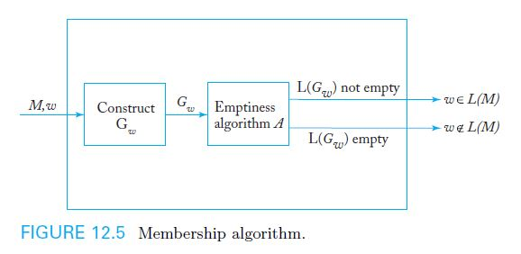
The Undecidability of the “L(G) = ∅” Problem
Figure 12.5 illustrates the process used to establish the result that the “L(G) = ∅” problem is undecidable
After G_{w} is built, the presumed emptiness algorithm A would be applied to G_{w}, giving a membership algorithm for recursively enumerable languages, which is impossible

Slide 12
Is the Language Accepted by a Turing Machine finite?
Given a Turing machine M, determine whether or not L(M) is finite
To show that the problem is undecidable,
Given a Turing machine M and string w, modify M to create a new machine M^, so that if any halting state of M is reached, M^ accepts all input
Have M^ generate w on an unused portion of its tape and perform the same computations as M, so that
if M halts in any configuration, then M^ halts in a final state, and
If M does not halt, then M^ will not halt either
As a result, M^ either accepts ∅ or the infinite language Σ⁺
Assuming there is an algorithm A for deciding whether or not L(M) is finite, we could apply it to M^, which would give us a solution to the halting problem
But this contradicts previous results that have established that the halting problem is undecidable

Slide 13
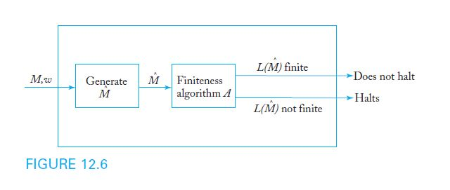
The Undecidability of the “L(M) is Finite” Problem
Figure 12.6 illustrates the process used to establish the result that the “L(M) is finite” question is undecidable
After an algorithm generates M^, the presumed finiteness algorithm A would be applied to M^, resulting in a solution to the halting problem, which is impossible

Slide 14
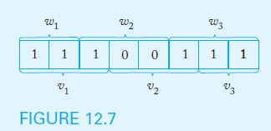
The Post Correspondence Problem
Given two sequences of n strings on some alphabet Σ, for instance
A = w₁, w₂, …, w_{n} and B = v₁, v₂, …, v_{n}
there is a Post correspondence solution (PC solution) for the pair (A, B) if there is a nonempty sequence of integers i, j, …, k, such that w_{i}w_{j}…w_{k} = v_{i}v_{j}…v_{k}
As shown in Example 12.5, assume A and B consist of
w₁ = 11, w₂, = 100, w₃ = 111 and v₁ = 111, v₂, = 001, v₃ = 11
A PC solution for this instance of (A, B) exists, as shown below

Slide 15
The Undecidability of the Post Correspondence Problem
The Post correspondence problem is to devise an algorithm that determines, for any (A, B) pair, whether or not there exists a PC solution
For example, there is no PC solution if A and B consist of
w₁ = 00, w₂, = 001, w₃ = 1000 and v₁ = 0, v₂, = 11, v₃ = 011
Theorem 12.7 states that there is no algorithm to decide if a solution sequence exists under all circumstances, so the Post correspondence problem is undecidable
Although a proof of theorem 12.7 is quite lengthy, this very important result is crucial for showing the undecidability of various problems involving context-free languages

Slide 16
Undecidable Problems for Context-Free Languages
The Post correspondence problem is a convenient tool to study some questions involving context-free languages
The following questions, among others, can be shown to be undecidable
Given an arbitrary context-free grammar G, is G ambiguous?
Given arbitrary context-free grammars G₁ and G₂,
is L(G₁) ∩ L(G₂) = ∅?
Given arbitrary context-free grammars G₁ and G₂,
is L(G₁) = L(G₂)?
Given arbitrary context-free grammars G₁ and G₂,
is L(G₁) ⊆ L(G₂)?

